Slide 1



INTRANET
Client: IT OFFICE, IIIT-H
TEAM 25
Aviral Malhotra Nilanjana De Shravani K. Siddharth Mago Vanshika Ahlawat

Slide 2

What was the need
of a new Intranet?
Can we make intranet a one stop destination for all document management functionalities?
What is the feasible
solution to these problems?
How to streamline user experience while at the same time keeping it simple and easy to use?
Was rebuilding the entire website resourcefully efficient? Why not just work on the older Intranet?

Slide 3
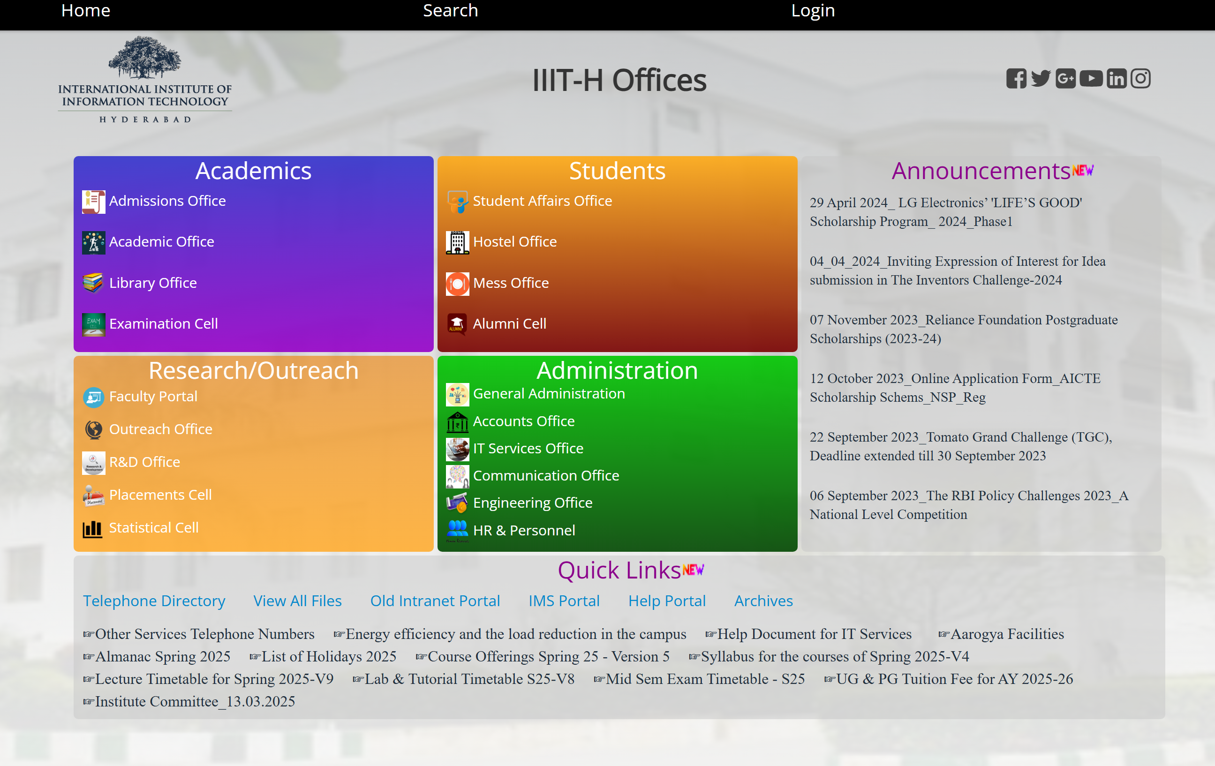
User Reviews
Isn’t visually appealing
Clutter and too much text
Search functionality
Doesn’t work properly
Gives outdated information due to difficult maintainability

Slide 4

No Versioning : Inability to track document history and changes.
Searchability : Poor global search facility
Complex Navigation : Existing layout causes user confusion
Static Non-Interactive Frontend
Redundant and Unclear Archive Features
Lack of important functionalities like preview, file path, edit PDF etc.
Drawbacks in the
Current Intranet

Slide 5
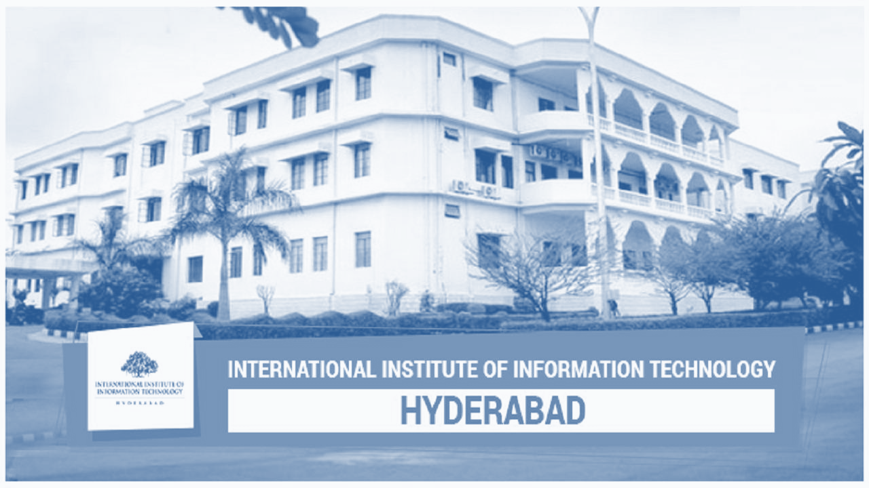



Keep it Simple!
Keep it Organized!
MOTIVATION
Keep it Interactive!

Slide 6
SOLUTION
Web2py's traditional framework can be modernized with MongoDB for improved scalability, flexibility and performance.
Additional Functionality to make the site more dynamic and interactive
Dynamic real-time announcements
Image functionality
Preview option
FAQs page
Streamlining user experience by
File path is shown for streamlined navigation
Document management made better by version control
Print to PDF with preview option
Content Management by Edit PDF option
Easy one page layout for all major functionalities
Combining redundant tabs
Interactive & Engaging Experience: FAQs page and responsive design for seamless workflows.

Slide 7
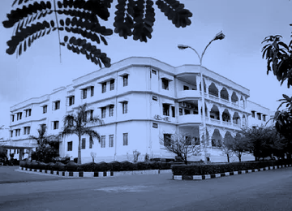
01
Communication is the Key
To address the lack of information and unclear client requirements, we prioritized open and continuous communication. Regular meetings, requirement gathering sessions, and direct discussions helped refine the client's vision. We ensured all stakeholders were aligned through detailed documentation, clarifying expectations at each phase. This approach minimised misunderstandings and enabled proactive problem-solving.
02
STRATEGIC GOALS
We Used the Prototype Life Cycle Model
Instead of a rigid development approach, we adopted the Prototype Life Cycle Model, which allowed us to build iterative versions of the intranet. This method helped us visualize and test solutions early, refining navigation, layout and document management features step by step. Prototyping enabled us to explore ways to fit essential elements on the homepage without compromising design.
03
Incorporated User Feedback at Every Step
User experience was central to our redesign, so we actively incorporated feedback throughout development. By engaging end-users and key stakeholders early, we could identify pain points and areas for improvement. Feedback sessions helped us refine navigation, optimize workflows, and streamline document version tracking. Iterative testing ensured the intranet remained intuitive, preventing feature overload while maintaining functionality.

Slide 8

CHALLENGES FACED
Ambiguity in client’s requirement
To accommodate the client’s requirement of having all key content on the main page without compromising design
Delayed response from the client
Tracking changes between different versions of documents
Making the website easily navigable without compromising on the features

Slide 9
FUTURE DELIVERABLES
BACKEND
TESTING
INTEGRATION
Database management - MongoDB
Version management
Integrates with CAS (Central Authentication Service)
Unit testing for all modules
Beta testing with selected end users (Office staff, HR, students, faculty)
Migrate database from MySQL to MongoDB
Integrate with IIIT server

Slide 10

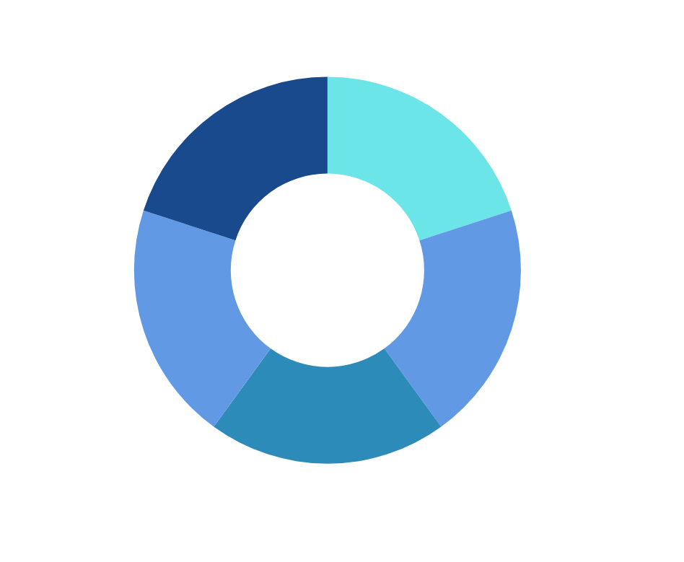

CONTRIBUTIONS
Requirement gathering from client
Incorporating Client feedback
Initial design proposal
Design draft
Front-end coding of pages using react
Unit testing for each module(page)
Designing individual pages
Prototype modeling
Designing different user views
Requirement analysis
Design draft
Designing individual pages
Designing different user views
Changing design until client is satisfied
Design draft
Final Integration of different modules(pages)
Testing after integration of different phases
Documentation

Slide 11
THANK YOU
We would like to answer any questions if you have any :)

